Slide 1

Human-Computer Interaction (HCI)
Mario Čagalj
University of Split
24.10.2012.

Slide 2
Task-Centered System Design
Based on slides by Saul Greenberg …

Slide 3
Seat-of-your-pants interface design
Is this a good or bad interface?
  do you go by gut feel?
  do you go by how it looks?
  do you judge it by familiarity to other interfaces?
  if there are problems, are they minor or serious?
  did you miss anything that you really shouldn’t have?
  is your opinion correct?
  how can you tell?
Alternative: are there methods where you can
  systematically determine if this interface matches the needs of its end users?
  systematically discover the usability bugs?
Notes:
If you do something by the seat of your pants, you achieve something, but only by a narrow margin or do something without advance preparation.

Slide 4
What is usability?
http://www.usabilitynet.org
Usability is the measure of the quality of a user's experience when interacting with a product or system
  The international standard, ISO 9241-11, defines it as: The extent to which a product can be used by specified users to achieve specified goals with effectiveness, efficiency and satisfaction in a specified context of use.
Usability is about:
  Effectiveness - can users achieve goals with the product?
  Efficiency - how much effort (time) do users require to do this?
  Satisfaction – what do users think about the products ease of use?
….which are affected by:
  The users, their goals, the usage situation (or ‘context of use’)
Usability should not be confused with ‘functionality‘
  Increased functionality does not mean improved usability!
Notes:
Usability means making products and systems easier to use, and matching them more closely to user needs and requirements
The international standard, ISO 9241-11, defines it as:
The extent to which a product can be used by specified users to achieve specified goals with effectiveness, efficiency and satisfaction in a specified context of use.
Usability is about:
Effectiveness - can users complete tasks, achieve goals with the product, i.e. do what they want to do?
Efficiency - how much effort do users require to do this? (Often measured in time)
Satisfaction – what do users think about the products ease of use?
….which are affected by:
The users - who is using the product? e.g. are they highly trained and experienced users, or novices?
Their goals - what are the users trying to do with the product - does it support what they want to do with it?
The usage situation (or 'context of use') - where and how is the product being used?
Usability should not be confused with 'functionality', however, as this is purely concerned with the functions and features of the product and has no bearing on whether users are able to use them or not. Increased functionality does not mean improved usability!

Slide 5
Task Centered System Design (TCSD)
Highly practical usability engineering methodology
  Introduced in 1993 by Clayton Lewis and John Rieman
  Simple to learn and apply
TCSD is a process where designers
  Articulate descriptions of real-world people doing their real-world tasks
  Use these descriptions to determine which users and what tasks the system should support
  Prototype an interface that satisfy these requirements
  Evaluate the interface by performing a task-centered walkthrough

Slide 6
An interface design process and usability engineering
Articulate:
who users are
their key tasks
Brainstorm designs
Refined designs
Completed designs
Goals:
Task-centered system design
Participatory design
User-centered design
Psychology of everyday
things
User involvement
Representation & metaphors
Graphical screen
design
Interface guidelines
Style
guides
Participatory interaction
Task scenario walk-
through
Evaluate
Usability testing
Heuristic evaluation
Field testing
Methods:
low fidelity prototyping methods
high fidelity prototyping methods
Products:
User and task descriptions
Throw-away paper prototypes
Testable prototypes
Alpha/beta systems or complete specification
Notes:
This diagram captures the major topics in the course and how they fit together as a process defining interface design and usability engineering.
The process goes left to right, where each major block showing the typical things that interface designers have to do. Each block indicates the goals to be accomplished, the methods (or tricks of the trade) that help accomplish those goals, and the products.
In practice, not every step or method is followed. Rather, the interface developer will choose methods appropriate to the time and budget of the project.

Slide 7
Working example: Cheap Shop
Note:
OmniTouch

Slide 8
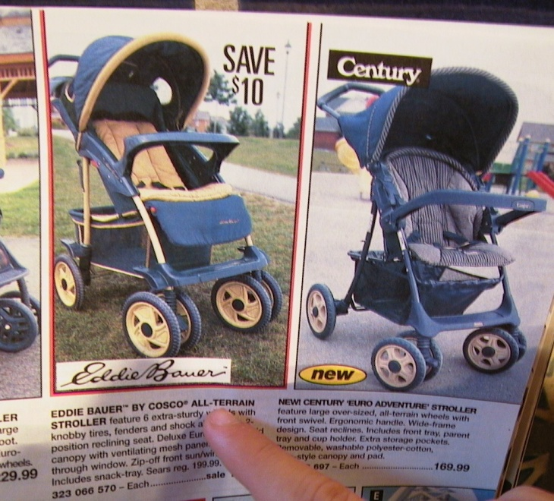
The Cheap Shop Catalog Store
  In Cheap Shop, people shop by browsing paper catalogs scattered around the store (IKEA).
  When people see an item they want, they enter its item code from the catalog onto a form.
  People give this form to a clerk, who brings the item(s) from the back room to the front counter.
  People then pay for the items they want.
Item code Amount

Slide 9
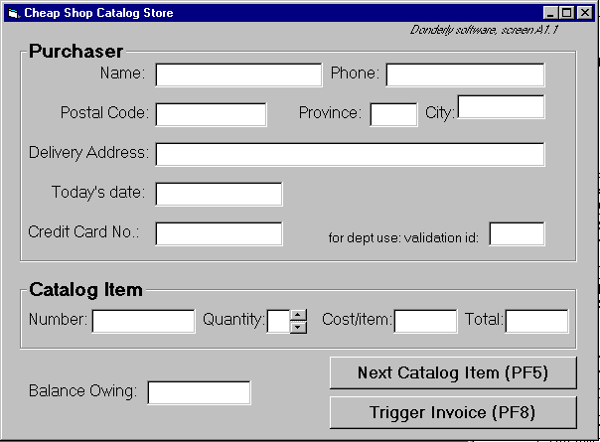
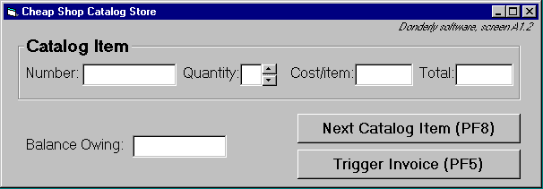
Your task
Cheap Shop contracts you to evaluate their in-store system prototype
  Customers would use this system
  to indicate and buy items
  System sends this request to
  the warehouse
Screen 1
Screen 2

Slide 10
Task Centered System Design (TCSD)

Slide 11
Task Centered System Design (TCSD)
An end-users perspective
  Exactly who would use the system to do exactly what?
TCSD main phases:
  Identification
    identify specific users and articulate their concrete tasks
  User-Centered Requirements Analysis
    decide which of these tasks and users the design will support
  Design
    base design representation and dialog sequences on these tasks
  Walkthrough Evaluations
    using your design, walk through these tasks to test the interface
Notes:
1. In the first phase of task-centered system design, you identify specific users of the system
and articulate example realistic tasks that they would do. Your goal is to produce a
manageable list of representative users and tasks that give realistic coverage of who
would use the system to do what kinds of tasks. To achieve this goal, you need to first
discover what tasks users do, then write these up as task descriptions, and finally validate
the descriptions to make sure they represent reality.
2. User-Centered Requirements Analysis
You will rarely design a system that handles all possible users and tasks equally well.
This could be because you do not have the budget to develop an all-encompassing
system, or because the diversity of possible users and tasks is too high to be handled by a
common system, or because you cannot cost-justify certain features. As a rule of thumb,
most systems are considered successful if they have about 90% coverage, that is, if 90%
of the people can do 90% of the tasks reasonably well. This also means that these systems
exclude 10% of the people and tasks. The next phase in TCSD is for you to decide what
people and tasks will be included or excluded from your design. This list will become
your basic user-centered requirements analysis of your system design.
3. With the descriptions and requirements in hand, you can now start thinking about the
interface design. Each description creates the character and plot of a story. You generate
design possibilities by exploring how specific designs support the telling of this story.
Each design should consider how its features work together to help a person accomplish
their real work. Each design should account for the expected user knowledge and
motivation, where it takes into consideration the real world contexts of real users.
As design ideas unfold, you can judge and quickly modify your interface by seeing
how well it supports the story told by your core set of user/task descriptions. That is, you
can perform an ‘in the small’ task-centered walkthrough (discussed in Phase 4) to see
how well your interface and its features support particular user types and tasks.
4. Evaluate via Task-Centered Walkthroughs
A usage scenario combines an interface design with one of your user/task descriptions.
In this phase, you choose a scenario and perform a task centered walkthrough of it
(Nielson and Mack 1994). With a walkthrough, you tell a concrete story about what a
particular user would do and see step-by-step when performing his or her particular task
on the interface (Carroll, 2000).
Walkthroughs are an excellent and low-cost way to evaluate your interface, for you
will quickly discover trouble spots as you move through the task. At its cheapest, you
can do it by yourself, with no need for end-user involvement. However, walkthroughs
tend to produce richer results when they are performed with others on your team,
particularly if other members have perspectives that differ from yours e.g., designers,
implementers, and end-users.

Slide 12
Phase 1: Identify users + tasks
Get in touch with real people who will be potential users of your system
  prototypical categories
  extremes
Learn about their real tasks
  articulate concrete, detailed examples of tasks they perform or want to perform that your system should support
    routine
    infrequent but important
    infrequent and incidental

Slide 13
Phase 1: Identify users + tasks
How do you identify tasks?
  Immerse yourself in a real person’s environment
  Observe people in their actual work context
  Interview people as they do their work
  Shadow a person over the course of his or her day
  Serve people’s requests
  …
Example:
Ericsson e-Health solution for pharmacy shops
Notes:
ETK example: something that one cannot possibly learn by getting the list with requirements from the management

Slide 14
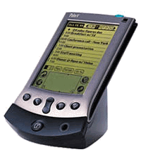
Phase 1: Identify users + tasks
If there are no real users or tasks…
  think again, there probably are!
  Jeff Hawkins, the inventor of the Palm Pilot, was said to
  have carried a small block of wood around in his shirt pocket … As various everyday situations arose, he would take out the block of wood and imagine how he would use the device.
  The same technique can be used to evoke a response from expected end-users

Slide 15
Phase 1: Identify users + tasks
If all else fails (no observations nor interviews)…
  describe your expected set of users,
  describe your expected set of tasks
These will become your ‘assumed users and tasks’
  verify them later as information comes in
  modify them as needed

Slide 16
Phase 1: Developing good task descriptions
You must write up the results of your observations and interviews. The description follows five important criteria:
Says what user wants to do but does not say how they would do it
  no assumptions made about the interface
  can be used to compare design alternatives in a fair way
Are very specific
  says exactly what the user wants to do
  specifies actual items the user would somehow want to input

Slide 17
Phase 1: Developing good task descriptions
Describes a complete job
  forces designer to consider how interface features work together
  contrasts how information input / output flows through the dialog
      where does information come from?
      where does it go?
      what has to happen next?
    Do not
      create a list of simple things the system should do
      present a sub-goal independent of other sub-goals

Slide 18
Phase 1: Developing good task descriptions
Says who the users are
  name names, if possible
  says what they know
  Why?
    design success strongly influenced by what users know
    can go back and ask them questions later
    reflects real interests of real users
    helps you find tasks that illustrate functionality in that person’s real work context

Slide 19
Phase 1: Developing good task descriptions
Are evaluated
  Circulate descriptions to users, and rewrite if needed
    ask users for
      omissions
      corrections
      clarifications
      suggestions
As a set, identifies a broad coverage of users and task types
  the typical ‘expected’ user, typical routine tasks
  the occasional but important user, infrequent but important tasks
  the unusual user unexpected or odd tasks

Slide 20
Phase 2: Requirements
Which user types will be addressed by the interface?
  designs can rarely handle everyone!
  includes why particular users are included / excluded
Which tasks will be addressed by the interface?
  designs can rarely handle all tasks
  requirements listed in terms of how they address tasks
    Absolutely must include
    Should include (if budget and time permits)
    Could include (if can be included almost ‘for free’)
    Exclude (unimportant)
  discussion includes why items are in those categories
Rule of thumb: 90% coverage, i.e., 90% of the people can do 90% of the tasks reasonably well

Slide 21
Phase 3: Design through Scenarios
Develop designs to fit users and specific tasks
  ground interfaces in reality
Use tasks to
  get specific about possible designs
  consider the real world contexts of real users
  consider how design features work together
    what would the user do / see step-by-step when performing this task?

Slide 22
Phase 4: Walk-through Evaluation
You choose scenario and perform task centered walkthrough of it
  Good for debugging an interface
  No need for end-user involvement (do it yourself or better with your team)
    Put yourself in the mind and context of the end user
Lewis and Rheiman’s walkthrough algorithm
  Select one of the task scenarios
  For each user’s step/action in the task:
    can you build a believable story that motivates the user’s actions?
    can you rely on user’s expected knowledge and training about system?
    if you cannot:
      you’ve located a problem in the interface!
      note the problem, including any comments
      assume it has been repaired
  go to the next step in the task

Slide 23
An interface design process and usability engineering
Articulate:
who users are
their key tasks
Brainstorm designs
Refined designs
Completed designs
Goals:
Task-centered system design
Participatory design
User-centered design
Psychology of everyday
things
User involvement
Representation & metaphors
Graphical screen
design
Interface guidelines
Style
guides
Participatory interaction
Task scenario walk-
through
Evaluate
Usability testing
Heuristic evaluation
Field testing
Methods:
low fidelity prototyping methods
high fidelity prototyping methods
Products:
User and task descriptions
Throw-away paper prototypes
Testable prototypes
Alpha/beta systems or complete specification
Notes:
This diagram captures the major topics in the course and how they fit together as a process defining interface design and usability engineering.
The process goes left to right, where each major block showing the typical things that interface designers have to do. Each block indicates the goals to be accomplished, the methods (or tricks of the trade) that help accomplish those goals, and the products.
In practice, not every step or method is followed. Rather, the interface developer will choose methods appropriate to the time and budget of the project.

Slide 24
Working example: Cheap Shop

Slide 25
The Cheap Shop Catalog Store
  In Cheap Shop, people shop by browsing paper catalogs scattered around the store (IKEA).
  When people see an item they want, they enter its item code from the catalog onto a form.
  People give this form to a clerk, who brings the item(s) from the back room to the front counter.
  People then pay for the items they want.
Item code Amount

Slide 26
Your task
Cheap Shop contracts you to evaluate their in-store system prototype
  Customers would use this system
  to indicate and buy items
  System sends this request to
  the warehouse
If the prototype has major
problems
  Suggest changes (to repair)
  Proposa a new design
Screen 1
Screen 2

Slide 27
The Cheap Shop Prototype Specifications
To order the first item:
  shoppers follow sequence on screen 1 to enter their personal information and their first order;
  text is entered via keyboard, and the tab or mouse is used to go between fields.
To order additional items:
  shoppers fill in screen 2 after clicking Next Catalog Item (can be repeated).
To complete an order:
  shoppers click Trigger Invoice;
  the system automatically tells shipping and billing about the order;
  the system returns to a blank screen #1.
To cancel the order:
  shoppers do not enter input for 30 seconds (as if they walk away);
  the system will then clear all screens and return to the main screen.
Input checking:
  all input fields checked when either button is pressed;
  erroneous fields will blink for 3 seconds, and will then be cleared;
  the shopper can then re-enter the correct values in those fields.

Slide 28
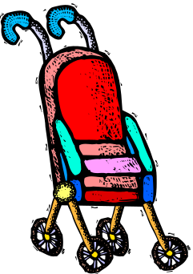
Developing task descriptions
Task description 1
  Fred Johnson, who is caring for his demanding toddler son, wants a good quality umbrella stroller (red is preferred, but blue is acceptable).
  He browses the catalog and chooses the JPG stroller
  (cost $98. item code 323 066 697).
  He pays for it in cash, and uses it immediately.
  Fred is a first-time customer to this store, has little
  computer experience, and says he types very slowly
  with one finger. He lives nearby on Dear Bottom
  Avenue NW.
JPG Stroller. This well made but affordable Canadian stroller fits children between 1-3 years old. Its wheels roll well in light snow and mud.
…$98.
Red: 323 066 697
Blue: 323 066 698

Slide 29
Developing task descriptions
Discussion
  Fred has many properties of our typical expected user:
    many customers are first time shoppers,
    a good number have no computer experience
    a good number are poor typists.
  The task type is routine and important.
    many people often purchase only one item
    a good number of those pay by cash
    as with Fred, people often have a general sense of what they want to buy, but decide on the actual product only after seeing what is available.

Slide 30
Developing task descriptions
Task description 2
  Mary Vornushia is price-comparing the costs of a child’s bedroom set, consisting of a wooden desk, a chair, a single bed, a mattress, a bedspread, and a pillow all made by Furnons Inc.
  She takes the description and total cost away with her to check against other stores.
  Three hours later, she returns and decides to buy everything but the chair.
  She pays by credit card.
  She asks for the items to be delivered to her daughter’s home at 31247 Lucinda Drive, in the basement suite at the back of the house.
  Mary is elderly and arthritic.

Slide 31
Developing task descriptions
Discussion
  Like Mary,
    a reasonable number of store customers are elderly, with infirmities that inhibit their physical abilities.
    a modest number of them also enjoy comparison shopping, perhaps because they have more time on their hands or because they are on low income.
  The task type is less frequent, but still important.
    although this would be considered a ‘major’ purchase in terms of the total cost, the number of items purchased is not unusual.
    delivery of large items is the norm
    most customers pay by credit card for larger orders.

Slide 32
Developing task descriptions
Task description 3
  John Forham, the sole salesperson in the store, is given a list of 10 items by a customer who does not want to use the computer.
  The items are:
    4 pine chairs, 1 pine table, 6 blue place mats, 6 “lor” forks, 6 “lor” table spoons, 6 “lor” teaspoons, 6 “lor” knives, 1 “tot” tricycle, 1 red ball, 1 “silva” croquet set
  After seeing the total, the customer tells John he will take all but the silverware
  The customer then decides to add 1 blue ball to the list.
  The customer starts paying by credit card, but then decides to pay cash. The customer tells John he wants the items delivered to his home the day after tomorrow. While this is occurring, 6 other customers are waiting for John.
  John has been on staff for 1 week, and is only partway through his training program

Slide 33
Developing task descriptions
Discussion
  This task introduces the clerk as a system user.
    Because the store has a high turnover in its staff, new employees such as John are also common.
    Thus John reflects a ‘rare’ but important group of users.
  The task type is less frequent, but still important
    The task, while complex, is fairly typical i.e., people making large numbers of purchases often ask the clerk to help them.
    Similarly, clerks mention that customers often change their mind partway through a transaction i.e., by changing what they want to buy and/or by changing how they want to pay for it.
    Customers, however, rarely give specific delivery dates, with most wanting delivery as soon as possible.
    Lineups for clerks are common during busy times.

Slide 34
Cheap Shop prototype
Cheap Shop already have an interface in hand
  we begin by performing a
  task centered walkthrough of it
  our walkthrough analysis
  done with a scenario that
  combines our initial task
  descriptions with this
  interface
Screen 1
Screen 2

Slide 35
The Cheap Shop Prototype Specifications
To order the first item:
  shoppers follow sequence on screen 1 to enter their personal information and their first order;
  text is entered via keyboard, and the tab or mouse is used to go between fields.
To order additional items:
  shoppers fill in screen 2 after clicking Next Catalog Item (can be repeated).
To complete an order:
  shoppers click Trigger Invoice;
  the system automatically tells shipping and billing about the order;
  the system returns to a blank screen #1.
To cancel the order:
  shoppers do not enter input for 30 seconds (as if they walk away);
  the system will then clear all screens and return to the main screen.
Input checking:
  all input fields checked when either button is pressed;
  erroneous fields will blink for 3 seconds, and will then be cleared;
  the shopper can then re-enter the correct values in those fields.

Slide 36
Walkthrough template
Task number: ____
Description of
Step
Does the user have the knowledge/training to do this?
Is it believable that they would do it?
Are they motivated?
Comment / solution
A walkthrough for this exercise is found in Greenberg, S. “Working through Task-Centered System Design. in Diaper, D. and Stanton, N. (Eds) The Handbook of Task Analysis for Human-Computer Interaction. Lawrence Erlbaum Associates.

Slide 37
Walkthrough: First task (Fred)
Interface: Cheap Shop prototype #1.
Description #1. Fred Johnson, who is caring for his demanding toddler son, wants a good quality umbrella stroller (red is preferred, but blue is acceptable). He browsers the catalog and chooses the JPG stroller (cost $98., item code 323 066 697). He pays for it in cash, and uses it immediately. Fred is a first-time customer to this store, has little computer experience, and says he types very slowly with one finger.

Slide 38
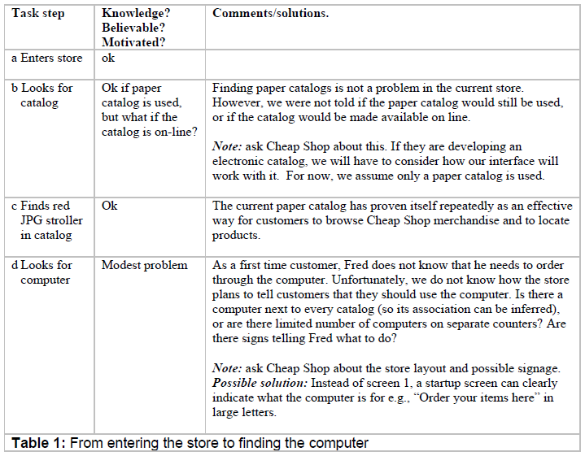
Walkthrough: First task (Fred) - Table 1

Slide 39
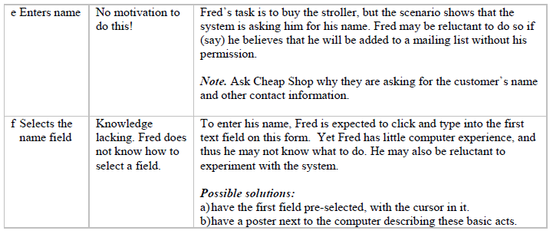
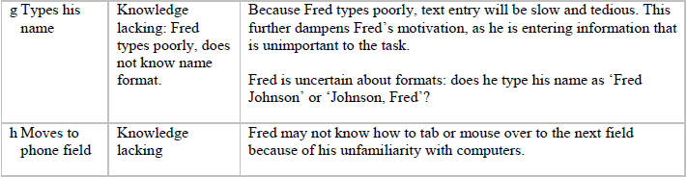
Walkthrough: First task (Fred) - Table 2

Slide 40
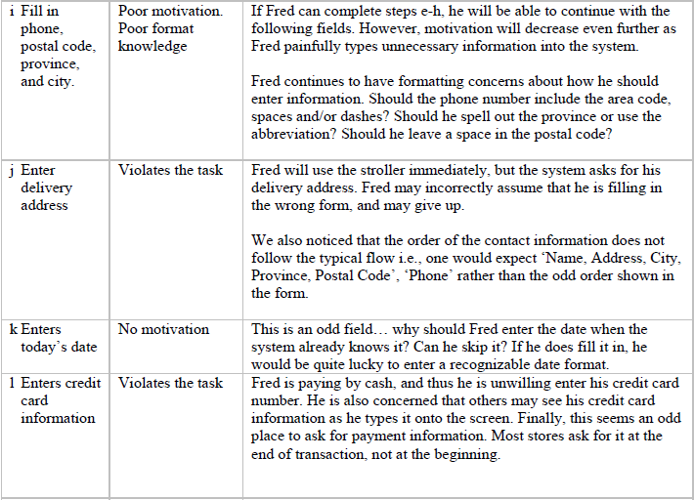
Walkthrough: First task (Fred) - Table 2

Slide 41
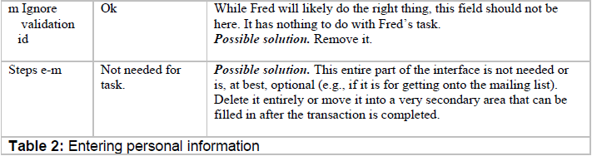
Walkthrough: First task (Fred) - Table 2

Slide 42
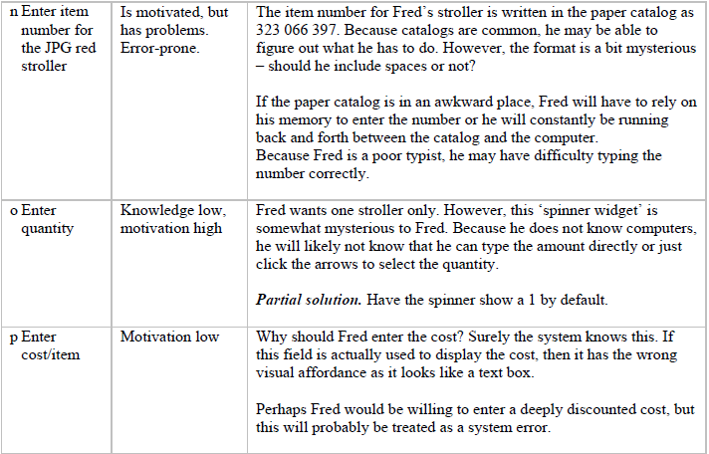
Walkthrough: First task (Fred) - Table 3

Slide 43
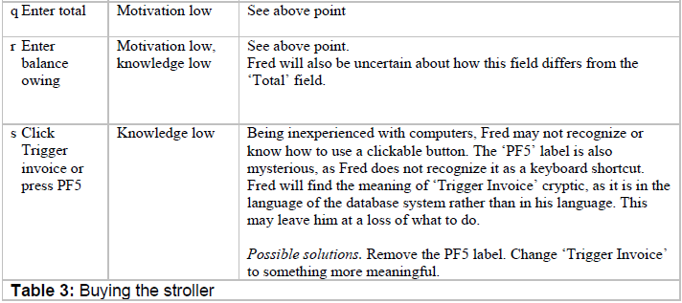
Walkthrough: First task (Fred) - Table 3

Slide 44
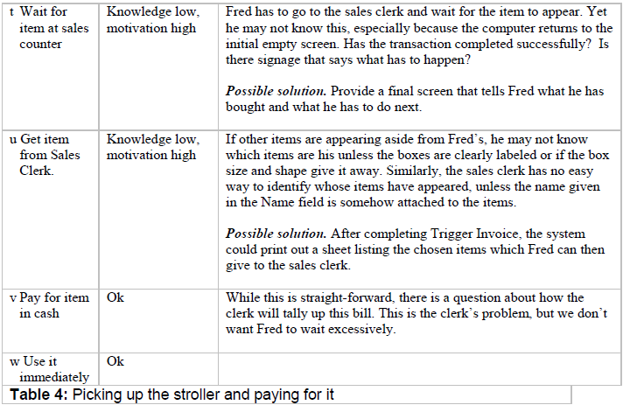
Walkthrough: First task (Fred) - Table 4

Slide 45
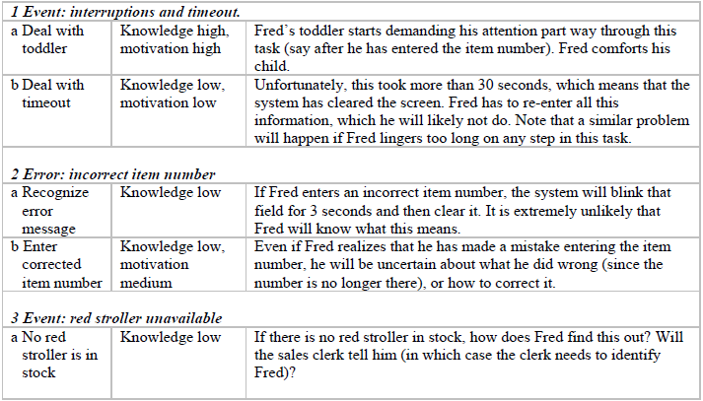
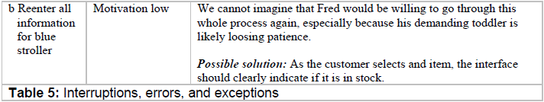
Walkthrough: First task (Fred) - Table 5

Slide 46
Walkthrough example
While Tables 1-5 appear detailed, they do not cover all task steps
  some left out as they are identical to previously seen task steps
  some simple forgotten (not thought about) – videotape or larger team
The other two descriptions yield other problems
  Task 2 (Mary)
    cannot use the mouse or type because she is arthritic
    when multiple items are ordered; the system gives no feedback of what was entered
    there is no way to correct errors without re-entering everything from scratch
    there is also no easy way for Mary to price-compare (since no printout is provided)
    there is no easy way for her to tell the system about the unusual delivery address (i.e., that it is the basement in the back)
  Task description 3 (John)
    the system prototype completely unsuitable for use by the store clerk (too slow, this affects customers waiting in line, the system cannot accomodate delayed delivery)
All in all, this design is disaster

Slide 47
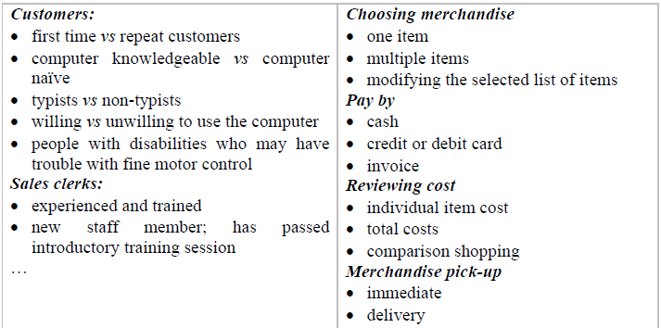
Redesigning the interface - phase 2
According to the task centered process, we have
  gone successfully through phase 1
    identified users + tasks, come up with the tasks descriptions
  in the next phase (phase 2: user-centered requirements)
    we make decision on which users and tasks should be supported
    to do this, we split the main user types and tasks in the following categories

Slide 48
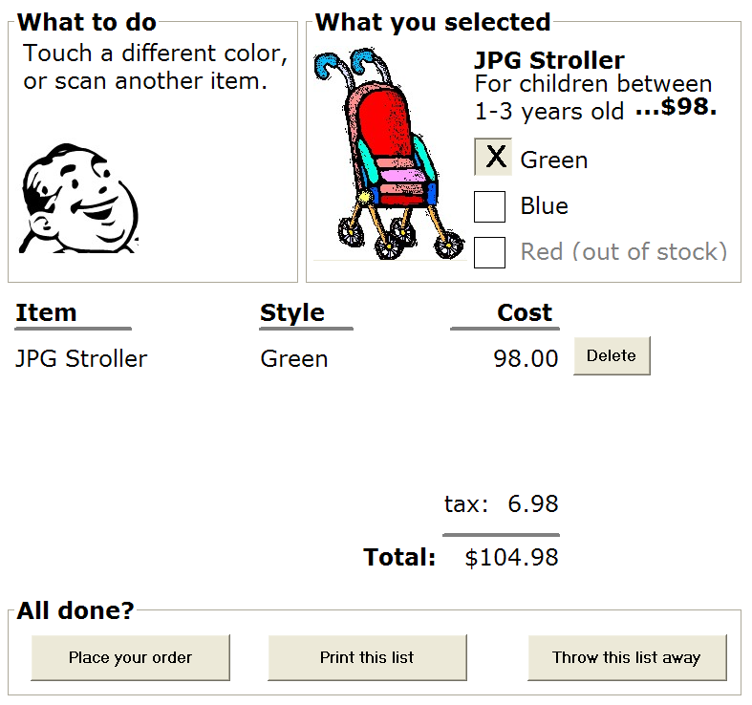
Redesigning the interface - phase 3
According to the task centered process, in phase 3
  by building on the previous requirements and our knowledge of the problems detected in our walkthrough, we prototype our interface
  partial wizard approach to tasks
  prototyped several different ways
    paper - 45 minutes
    scripted animation - 2 hours

Slide 49
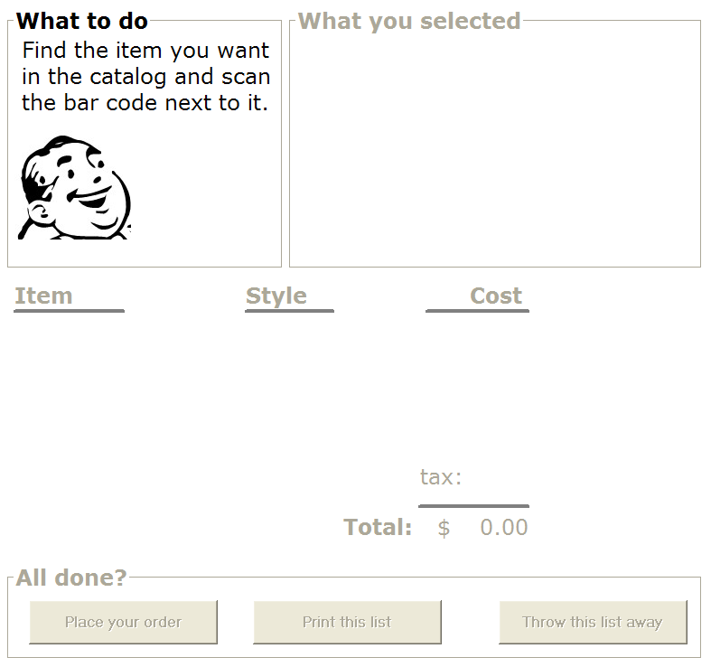


Slide 51


Slide 52


Slide 53
Printing…
To recall this order, scan the bar code on the printout

Slide 54
Your task
Does it work?
  do a task-centered walkthrough to find out!

Slide 55
Goal-centered system design
Articulate user goals instead of task sequences
  Goal:
    a desired end condition
    tend to be stable
  Task:
    an intermediate process needed to achieve the goal
    may change as technology / work patterns change
See Allan Cooper ‘The inmates are running the asylum’, Sams (Macmillan), especially Chapter 9 and 11.

Slide 56
Goal-centered system design
Designer
  looking for solutions that satisfy these goals
  task sequence may differ substantially from current process
Approach:
  Develop a persona
    precise, specific description of the user and the goal they wish to accomplish
    a pretend user that are hypothetical archetypes of actual users
    discovered as a by-product of investigating the problem domain
  Develop a cast of characters
    3 – 12 unique personas
    one will be the primary persona – the main focus of the design

Slide 57
Concluding words
Task-centered design and prototyping
  first step in an iterative user centered system design
  offers big ‘bang for the buck’
  not perfct (more precise techniques exist)
    not to be used for air traffic control system
    for non-critical systems under a limited budget
User centered system design
  not academic process where some book formula can be applied
  it is a hands-on process that requires you to go out and identify actual users, talk to them about what tasks they are trying to do, and understand the entire context of their work
  you then base your designs on this information you will have to identify potential usability problems by continually evaluating your design
  (iterative design)

Slide 58
You know now
How to develop concrete task examples
How to use task examples to motivate your designs
How to evaluate designs through task-centered walkthroughs

Slide 59
An interface design process and usability engineering
Articulate:
who users are
their key tasks
Brainstorm designs
Refined designs
Completed designs
Goals:
Task-centered system design
Participatory design
User-centered design
Psychology of everyday
things
User involvement
Representation & metaphors
Graphical screen
design
Interface guidelines
Style
guides
Participatory interaction
Task scenario walk-
through
Evaluate
Usability testing
Heuristic evaluation
Field testing
Methods:
low fidelity prototyping methods
high fidelity prototyping methods
Products:
User and task descriptions
Throw-away paper prototypes
Testable prototypes
Alpha/beta systems or complete specification
Notes:
This diagram captures the major topics in the course and how they fit together as a process defining interface design and usability engineering.
The process goes left to right, where each major block showing the typical things that interface designers have to do. Each block indicates the goals to be accomplished, the methods (or tricks of the trade) that help accomplish those goals, and the products.
In practice, not every step or method is followed. Rather, the interface developer will choose methods appropriate to the time and budget of the project.

